Slide 1

Obesity and Lymphoma, systematic review and meta-analysis
Mg. Víctor J. Vera Ponce
Médico Cirujano (URP)
Investigador asociado del Instituto de Investigaciones en Ciencias Biomédicas (INICIB-URP)
Efectividad Clínica (UBA), Epidemiología y bioestadística (UCSUR), Bibliometría (UJ) Medicina del Estilo de vida (URP), Nutrición clínica (VIU)

Slide 2


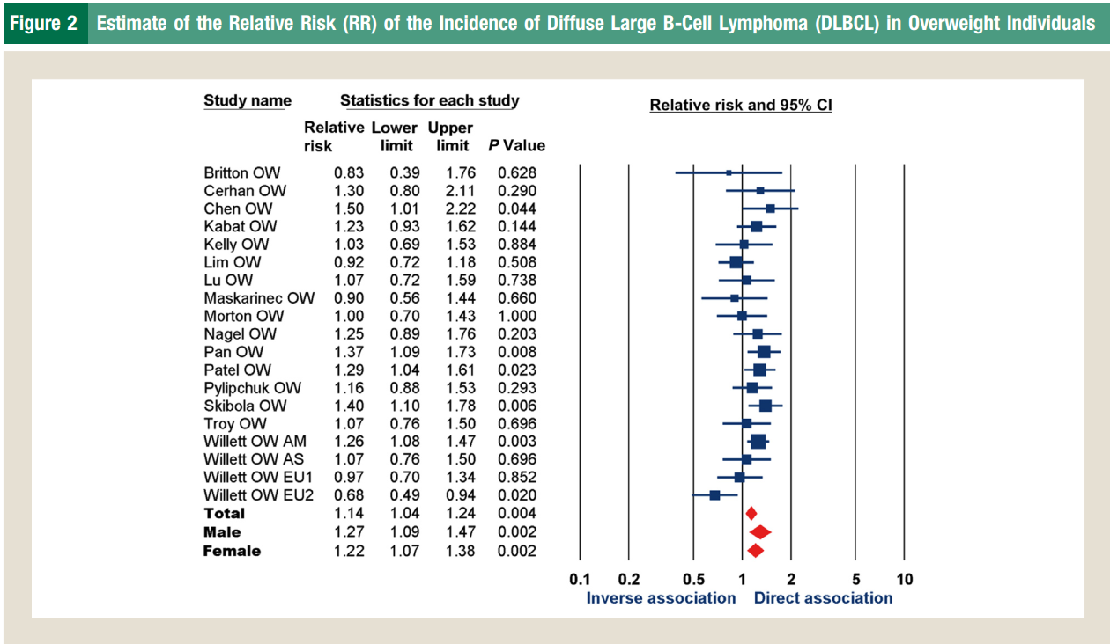

Slide 3


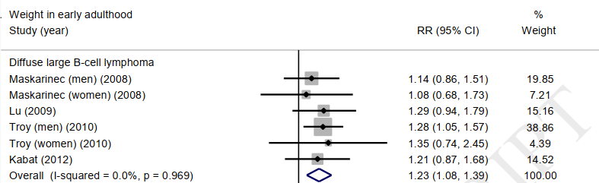

Slide 4
Methodology
Meta-analytic systematic review of observational studies
Databases: Pubmed/Medline, SCOPUS, Web of Science, and EMBASE
DLBCL diagnosis confirmed by biopsy
For Obesity: BMI
New Castle Ottawa
Measures of association: odds ratios (OR) or relative risks (RR)
I2 to heterogeneity
Random effects models as per DerSimonian and Laird's method

Slide 5
FLOWCHART

Slide 6
Meta-analysis of the association between obesity and DLBCL

Slide 7
Meta-analysis of the association between obesity and DLBCL
There is an association between BMI and the development of DLBCL.
The results of this meta-analysis highlight the need for further research into the complex relationships between adiposity, obesity, and chronic inflammation, and the development and progression of DLBCL.
Advancing in this field could have significant implications for reducing the incidence of this lymphoma and improving patient outcomes.

Slide 8


For any questions, write to:
victor.vera@urp.edu.pe

